Slide 1

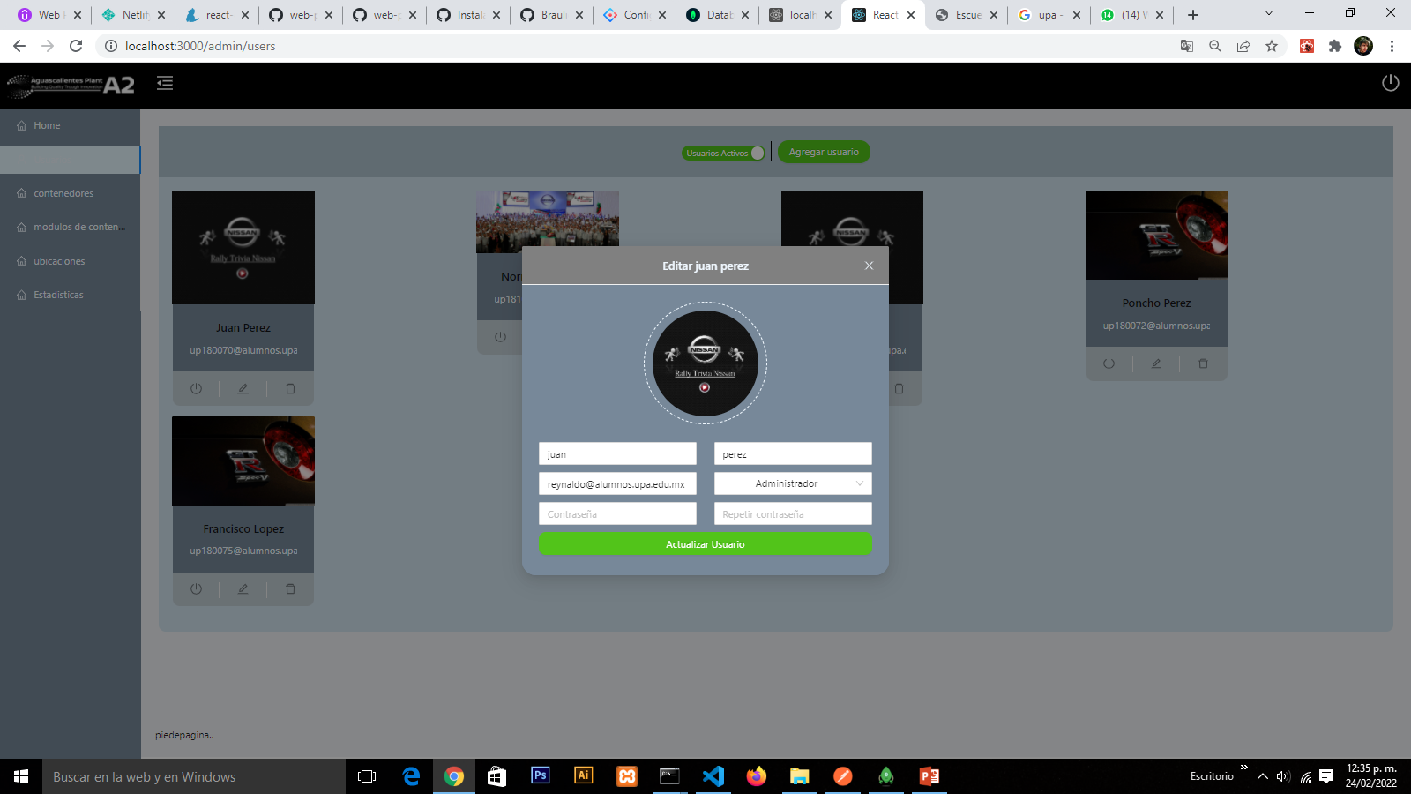

PROJECT:
Aplicativo para la evaluación de la revisión de la clasificación
KPI’s :
Compliance with global Nissan policy
Impact on classification revision time
Rodriguez Alvarez Braulio
MAIN ACTIVITIES:
Develop a web system for the administrative management of the revision of the classification.
Develop a mobile application for the review of the classification.
Universidad Politécnica de Aguascalientes
Ingeniería en sistemas estratégicos de la información
Area: Control Ambiental
Manager: Ribera Flores Marcos Antonio
Supervisor: Echeverría Rodríguez Reynaldo Amílcar
MAIN LEARNINGS:
How is waste management.
Classification Evaluation Process

Slide 2
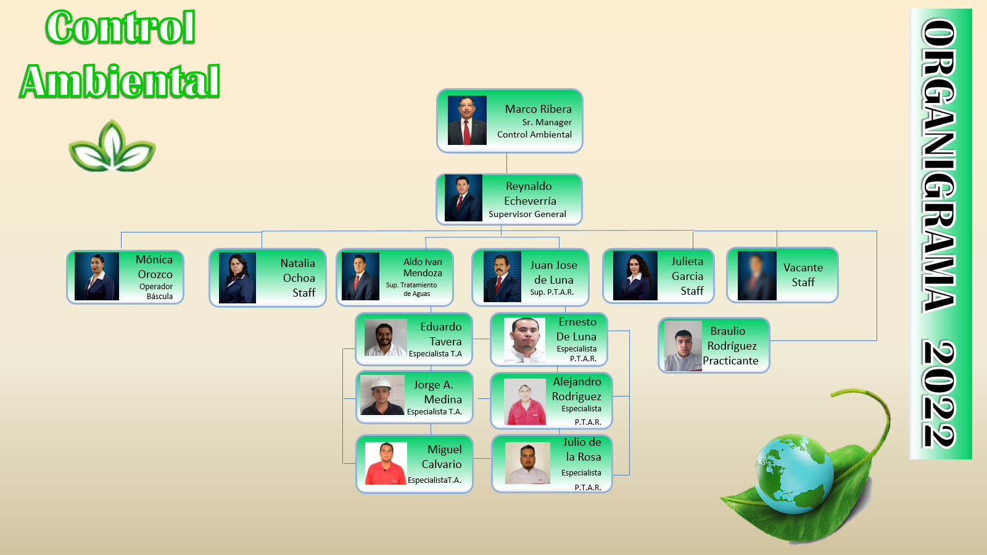
SELECTION OF THE SUBJECT

Slide 3
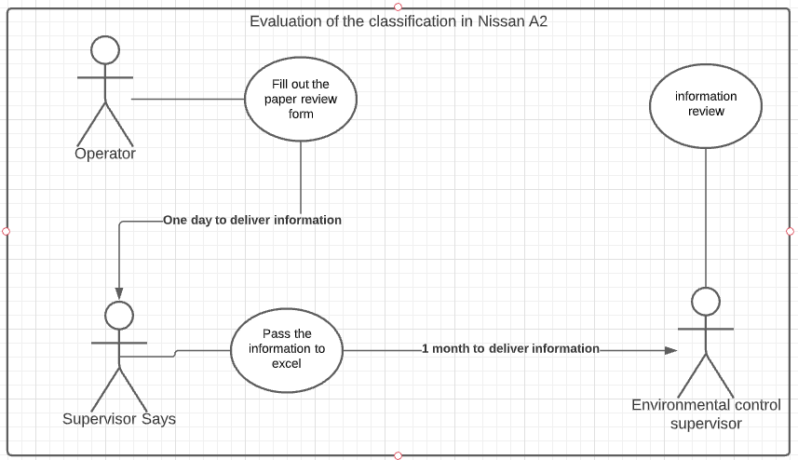
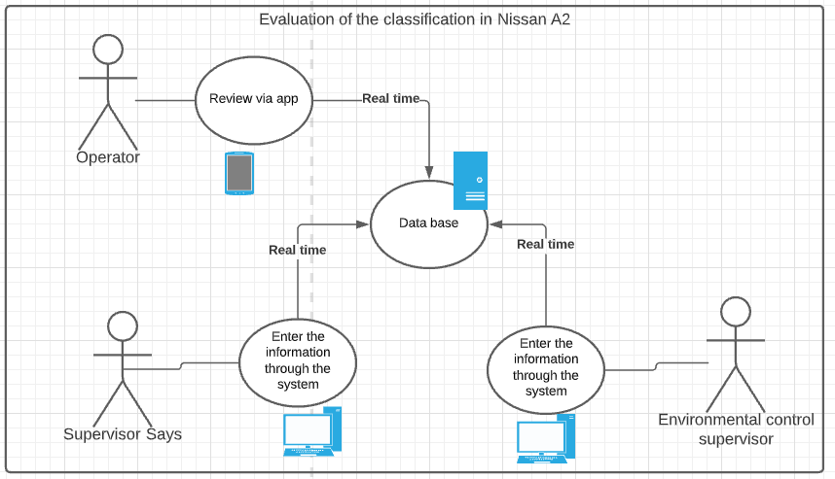
REASON FOR THE SELECTION OF THE SUBJECT
Automation of the classification review process to maintain data in real time
Actual process
Process with the system running

Slide 4
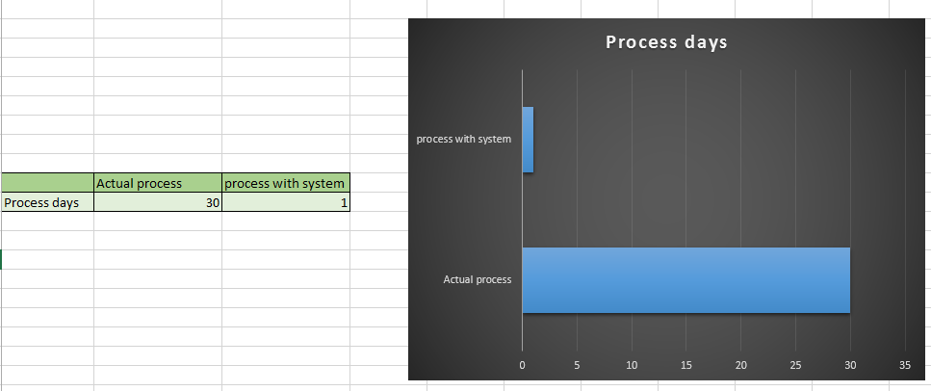
REASON FOR THE SELECTION OF THE SUBJECT

Slide 5
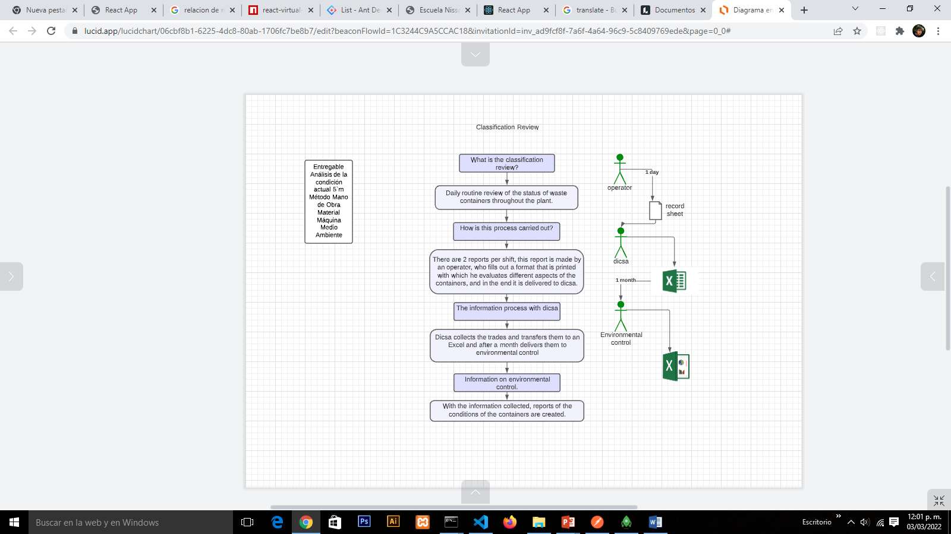
3.-KNOWLEDGE OF THE CURRENT SITUATION

Slide 6
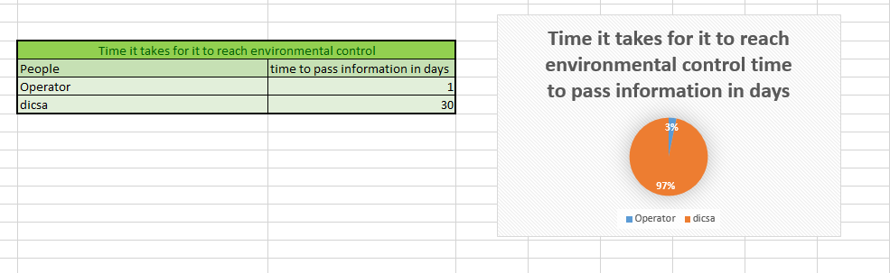
3.-KNOWLEDGE OF THE CURRENT SITUATION

Slide 7
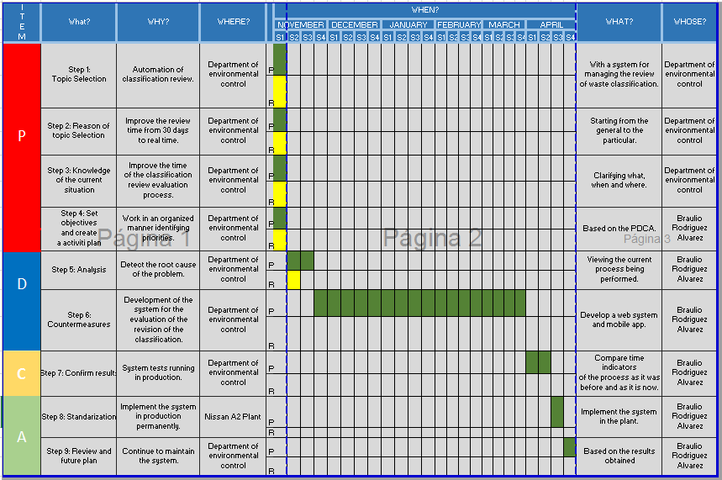
4.- Create an Activity Plan

Slide 8
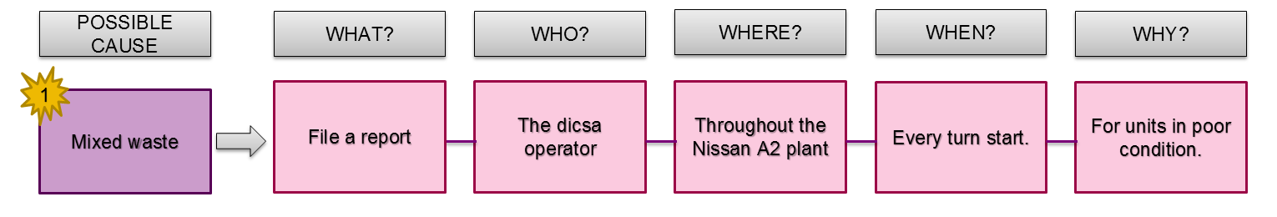
5.-Analysis
CONCLUTION:
What you want to avoid is the mixing of waste in the container modules, and time is one of the biggest factors in this problem.

